Slide 1

Comparison of Structural and Metabolic Biomarkers of Neurodegeneration for Brain Age Prediction
The Link Between Brain Age and Alzheimer’s Disease Development Using Different Modalities
Doering, E., Antonopoulοs, G., Hönig, M., van Eimeren, T., Eickhoff, S., Patil, K., Drzezga, A.

Slide 2

Nothing to disclose.

Slide 3




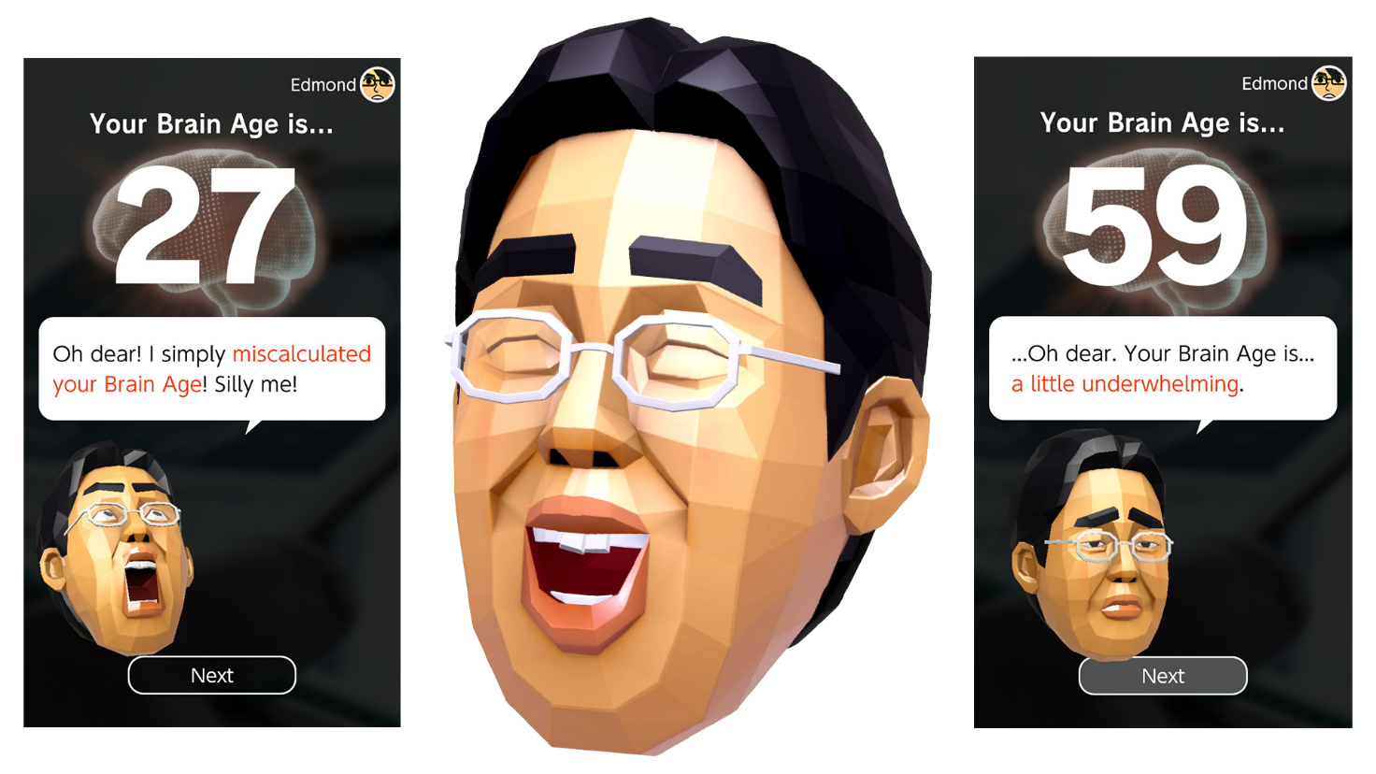
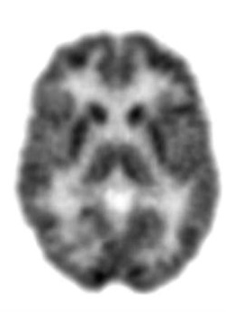
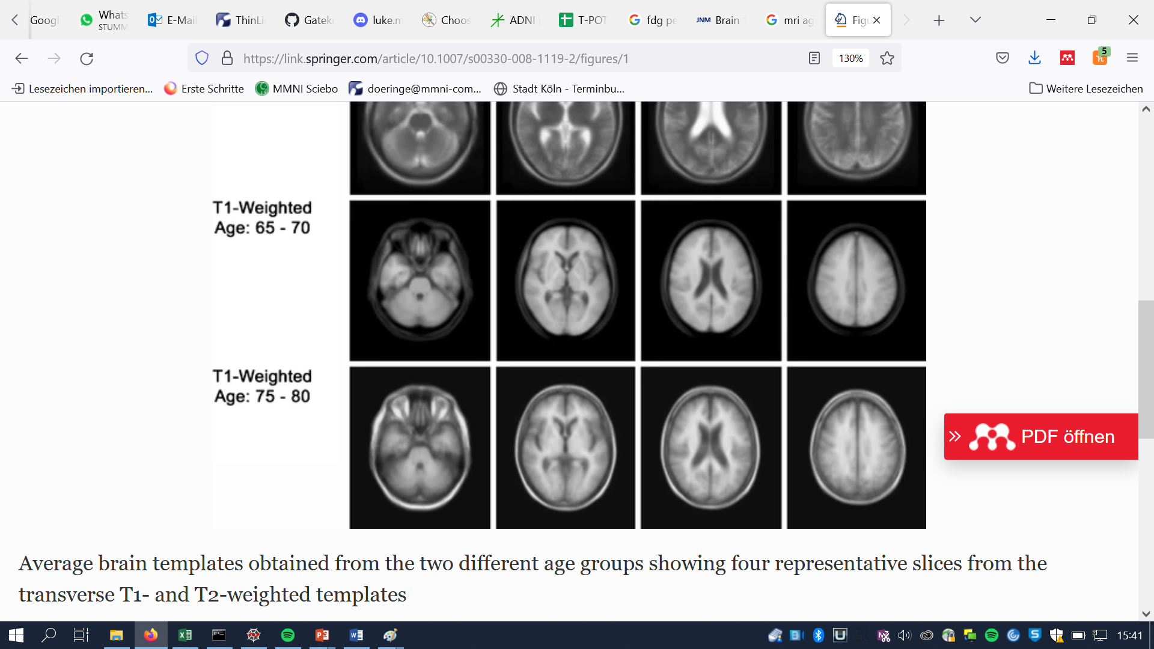
A biological definition of brain age

Slide 4


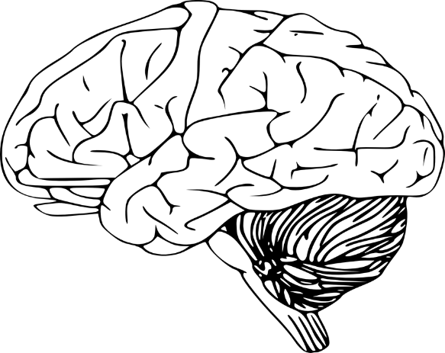
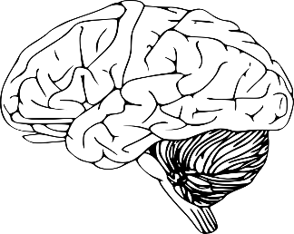

Brain-predicted age & BPAD
Brain-predicted age = machine learning algorithms learn to predict chronological age (CA) from brain scans
BPAD
= Difference between chronological age and brain-predicted age
- deviation from “normal” aging in a single number.
age = 75
CA = 63 BPA = 75
Chronological Age = 63 Brain age Prediction Brain-Predicted Age Difference = 12 years
Fig. 2. Schematic Illustration of Brain-Predicted Age Difference

Slide 5
Brain age can have various clinical functions
assess general brain health
detect disorders before symptom onset
support differential diagnosis

Slide 6
Research aims
Compare precision of brain-predicted age using MRI and FDG-PET in cognitively normal individuals (CN).
Compare association of MRI and FDG-PET-predicted age with cognitive function, neuropathology and cognitive decline in CN and individuals with mild cognitive impairment (MCI).
PET-predicted age
MRI-predicted age
Chronological age
Chronological age

Slide 7

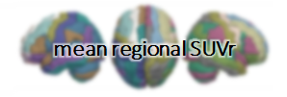


Compare precision of brain-predicted age in CN
379 FDG-PET and MRI scans from of CN from
frontal lobe left: 1.03 frontal lobe right: 1.25 … hippocampus left: 0.95 hippocampus right: 0.98
70 % training data (n = 256)
Trained model
30% testing data (n = 123)
+
External validation set (n = 59)

Slide 8
Sample
Overview of samples
 | Training data | Testing data
n total | 256 | 123 | 59
Age [years] | 74 | 73 | 72 (PET)/70 (MRI)
Sex (F/M) | 127/127 | 68/55 | 35/24
MMSE | 29 | 29 | 29
Education [years] | 16 | 16 | 16

Slide 9
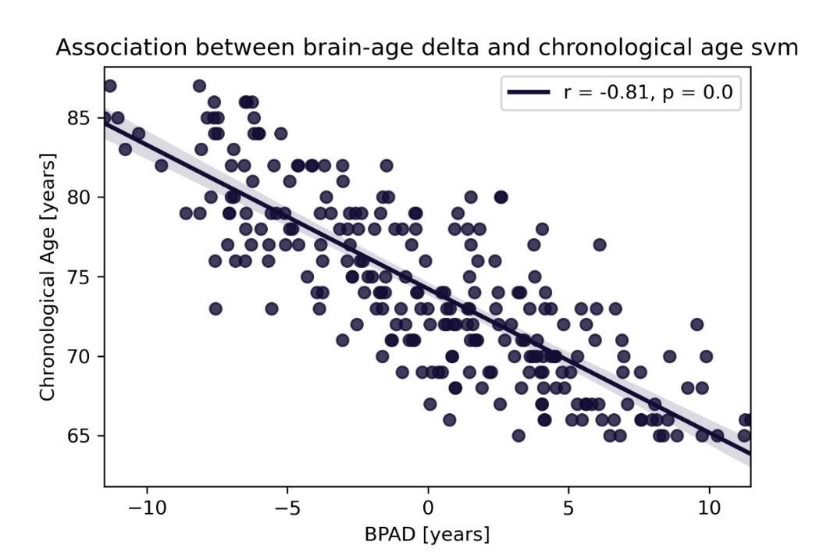
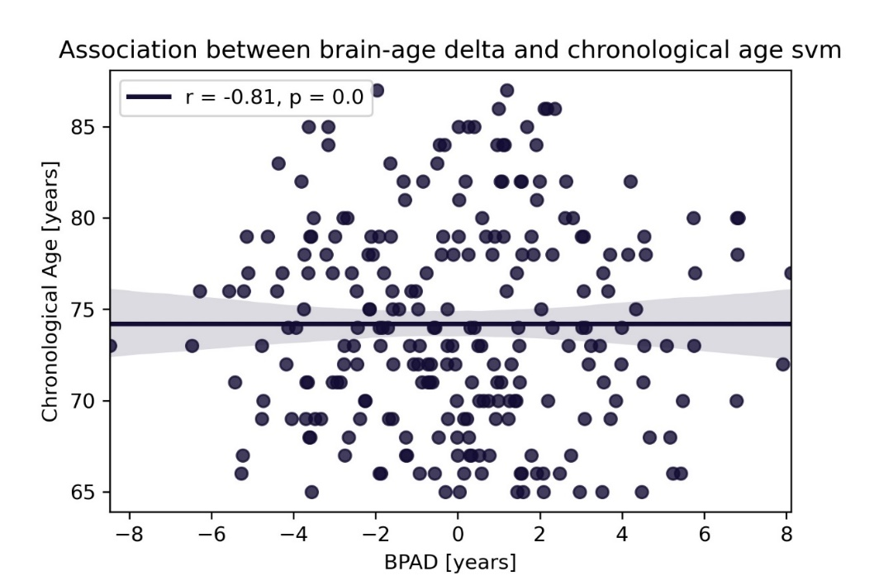
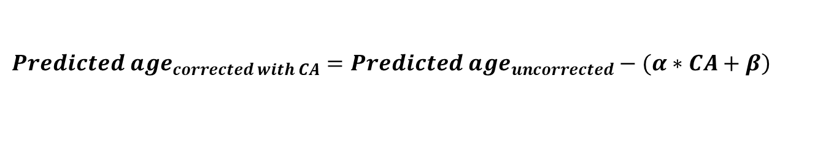
Bias Correction
$$\left.{Predicted age}_{corrected with CA}={Predicted age}_{uncorrected}−(α∗CA+β\right)$$
α = slope; β = intercept from linear model of CA X BPAD
PET
0, p = 1.0

Slide 10
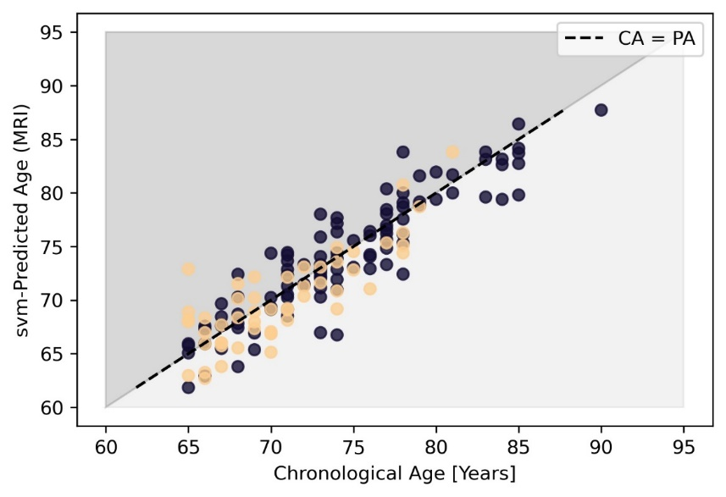


Brain age is better predicted with MRI
Performance on independent test set
PET MRI
ADNI
OASIS
MAE: 1.93 (ADNI: 1.82; OASIS: 2.16;
range*: 1.50 – 2.44, mean*: 1.97)
R²: 0.79 (ADNI: 0.81; OASIS: 0.72;
range*: 0.70 – 0.89, mean: 0.79)
Final model: SVM (SVM chosen as final model 50/50 times*)
MAE: 2.53 years (ADNI: 2.71; OASIS: 2.17; range*: 1.37 – 2.66, mean*: 2.03)
R²: 0.63 (ADNI: 0.62; OASIS: 0.57; range*: 0.58 – 0.90, mean*: 0.76)
Final model: SVM (SVM chosen as final model 43/50 times*)
* iteration of whole analysis over 50 different, randomly generated stratified train-test splits

Slide 11
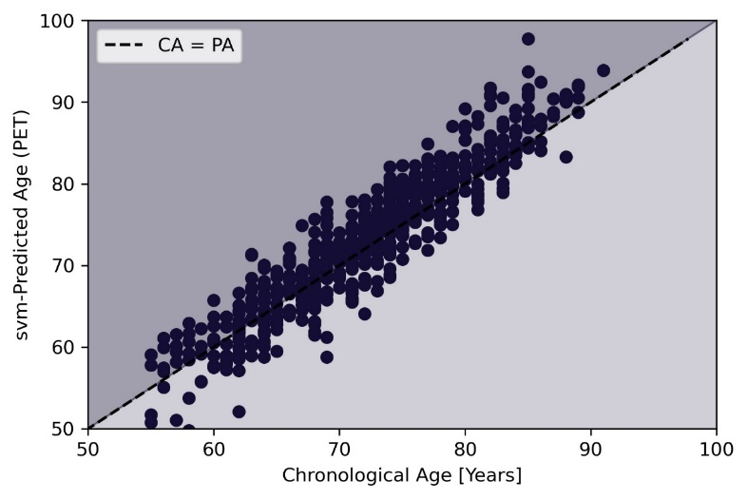
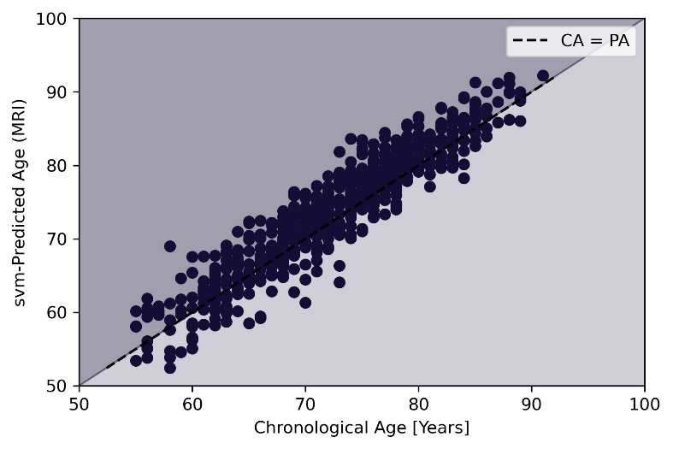
MRI/FDG-PET-predicted age and clinical symptoms of dementia
PET
MCI patients predicted
on avg. +1.07 years
older than CA
MRI
MCI patients predicted
on avg. +1.44 years
older than CA
 | MCI data
n total | 621
Age [years] | 73
Sex (F/M) | 264/355
MMSE | 28
CDR_SB | 1.5
Education [years] | 16

Slide 12
Correlations with cognitive performance/neuropathology
Training Sample
One test prediction for each subject
Test Sample
Cognitive Performance
ADNI-MEM (memory)
ADNI-EF (executive function)
Neuropathology
CSF ABETA
CSF Tau
CSF PTau
PET amyloid (AV45 global)
PET tau (AV1451 meta-ROI)

Slide 13
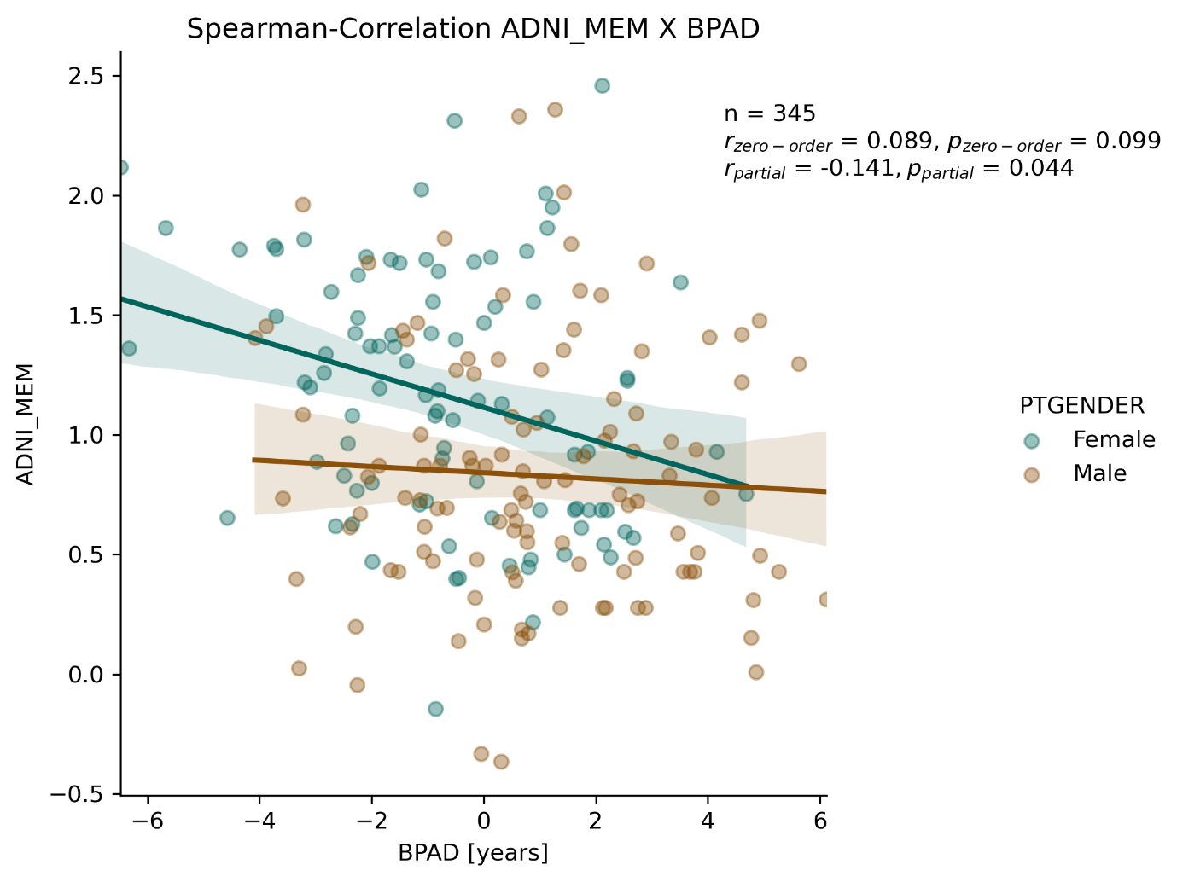
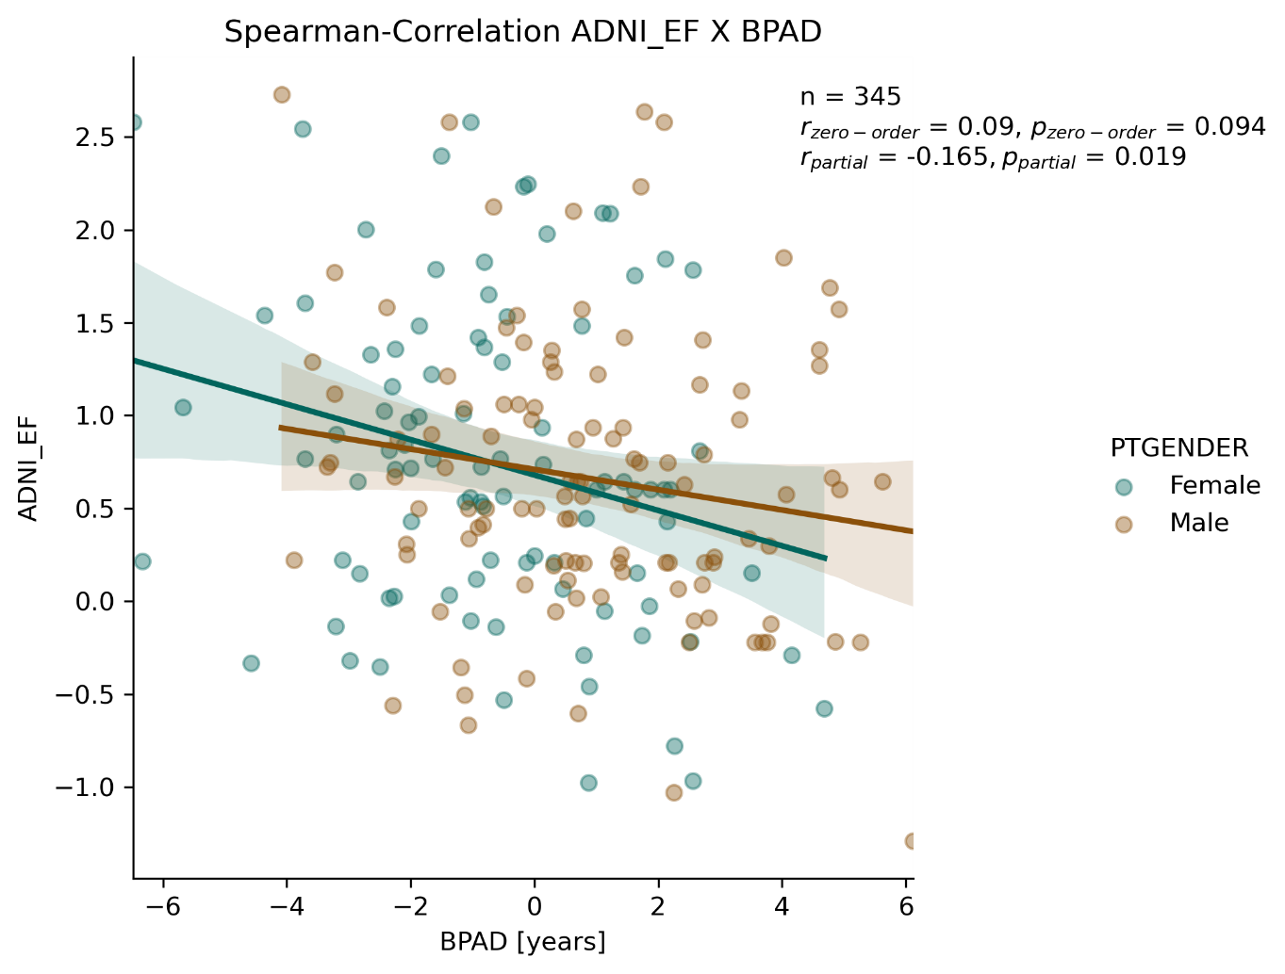
Higher MRI-BPAD is associated with worse cognitive performance in CN
Spearman correlations correcting for sex and chronological age
*
**
* Significant at p < 0.05, ** significant after Bonferroni correction (p < 0.025)

Slide 14
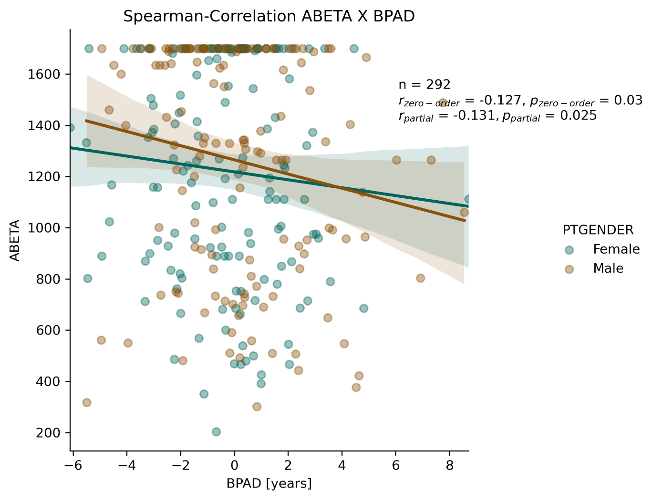
Higher PET-BPAD is associated with enhanced amyloid-β accumulation in CN
Spearman correlations correcting for sex and chronological age
*
*
* Significant at p < 0.05, ** significant after Bonferroni correction
Notes:
Under normal conditions, Abeta42 can be degraded by proteases, taken up by microglia, or cleared from the brain interstitial fluid across the blood brain barrier. Alternatively, it can be transported to the CSF and be cleared from there. Aggregation of Abeta42 appears the most likely cause for the decreased CSF Abeta42 concentration in AD: the aggregated state inhibits Abeta42 from being transported from the ISF to the CSF.

Slide 15
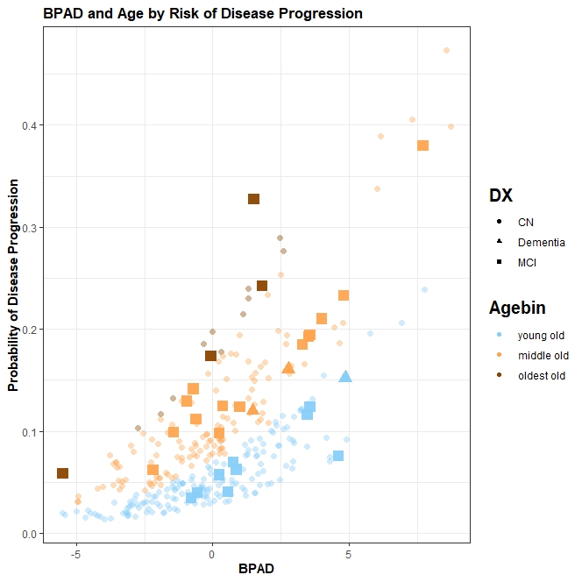
Disease progression can be predicted using FDG-BPAD and Age in CN
25% increased risk per one year BPAD to develop (mild) cognitive impairment within two years (95%CI [8%, 46%])*
*age: OR = 10% (95%CI [3%, 19%]), sex not significant in logistic regression
Disease progression not significantly associated with MRI-BPAD in CN
Logistic Regression
y = -9.87+0.23*BPAD+0.05*(Sex=Male)+0.97*Age
AUC = 0.73
25%

Slide 16
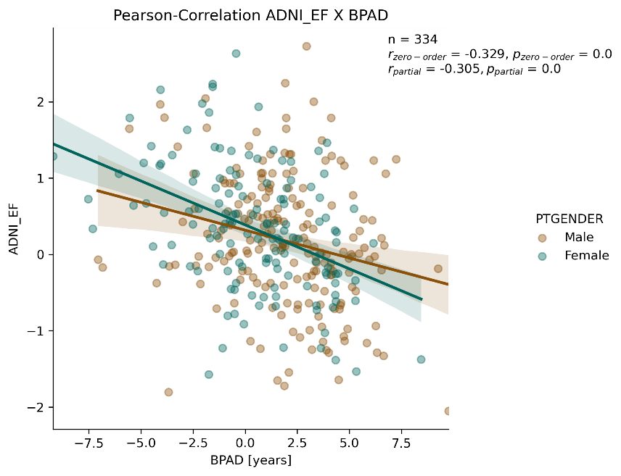
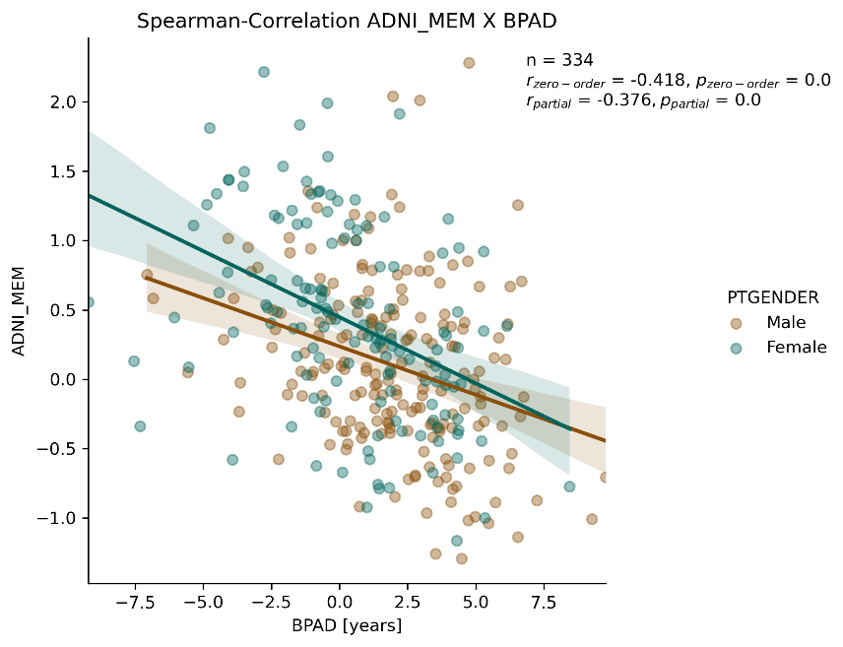
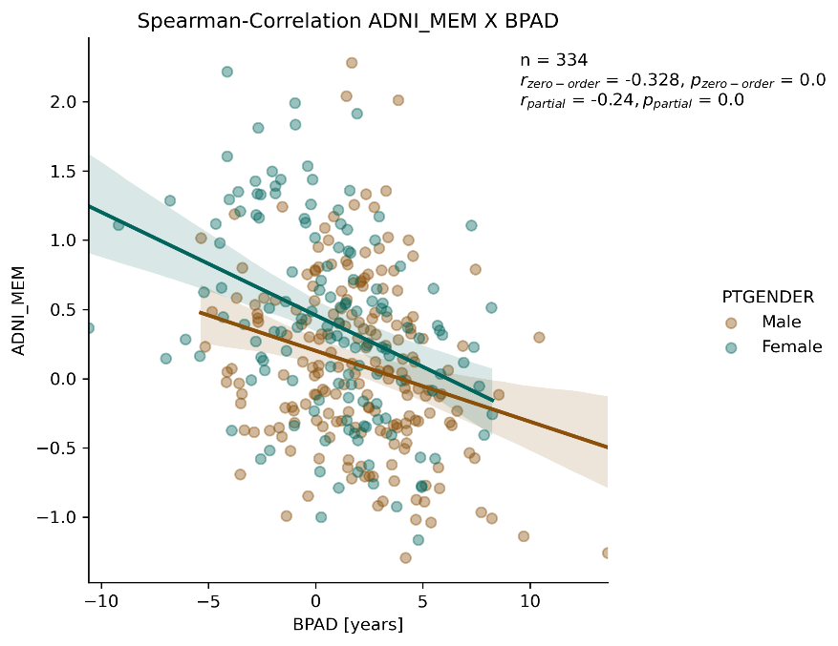
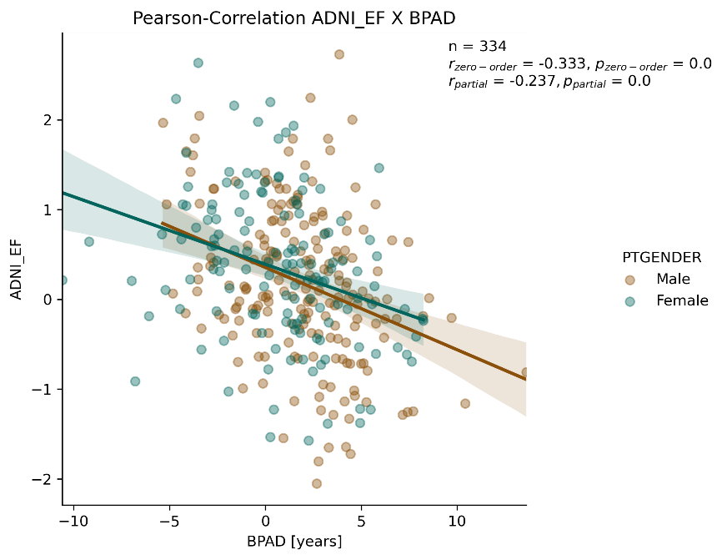
Higher BPAD (both modalities) is associated with worse cognitive performance in MCI
**
**
* Significant at p < 0.05, ** significant after Bonferroni correction
**
**
Stronger associations
Notes:
ADNI-MEM CRANE et al. 2012 XX
Follow-up paper:
YY EDUCATION/SLEEP/BRAIN HEALTH AS MODERATOR YY

Slide 17
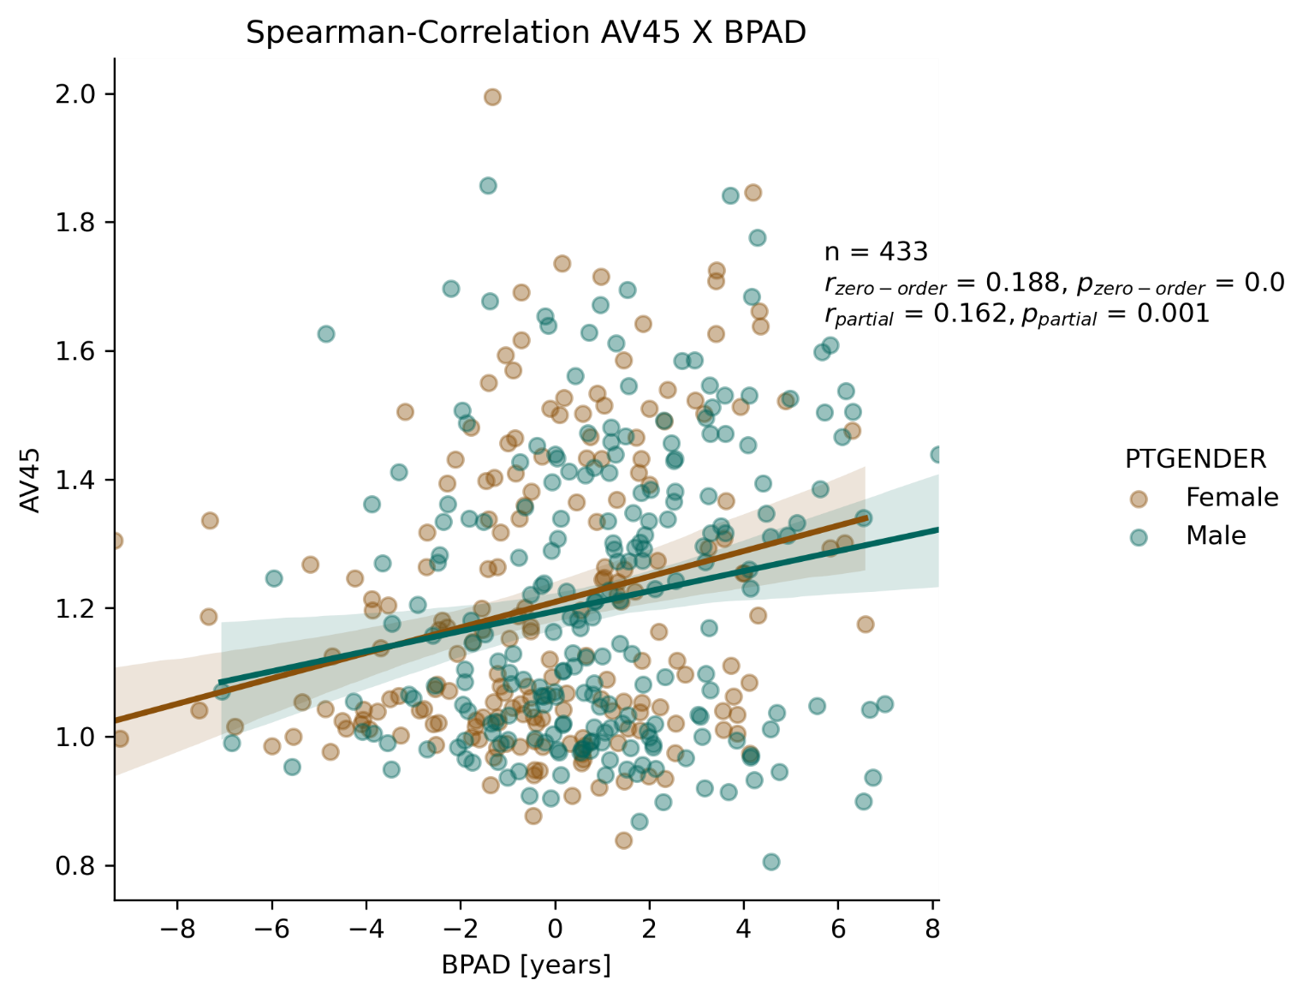
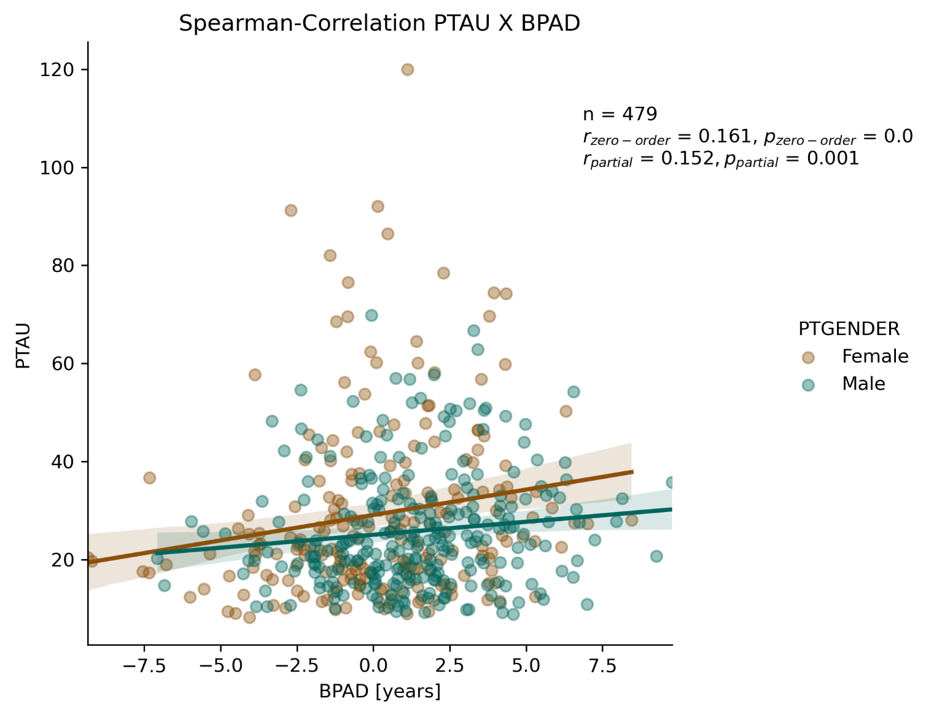
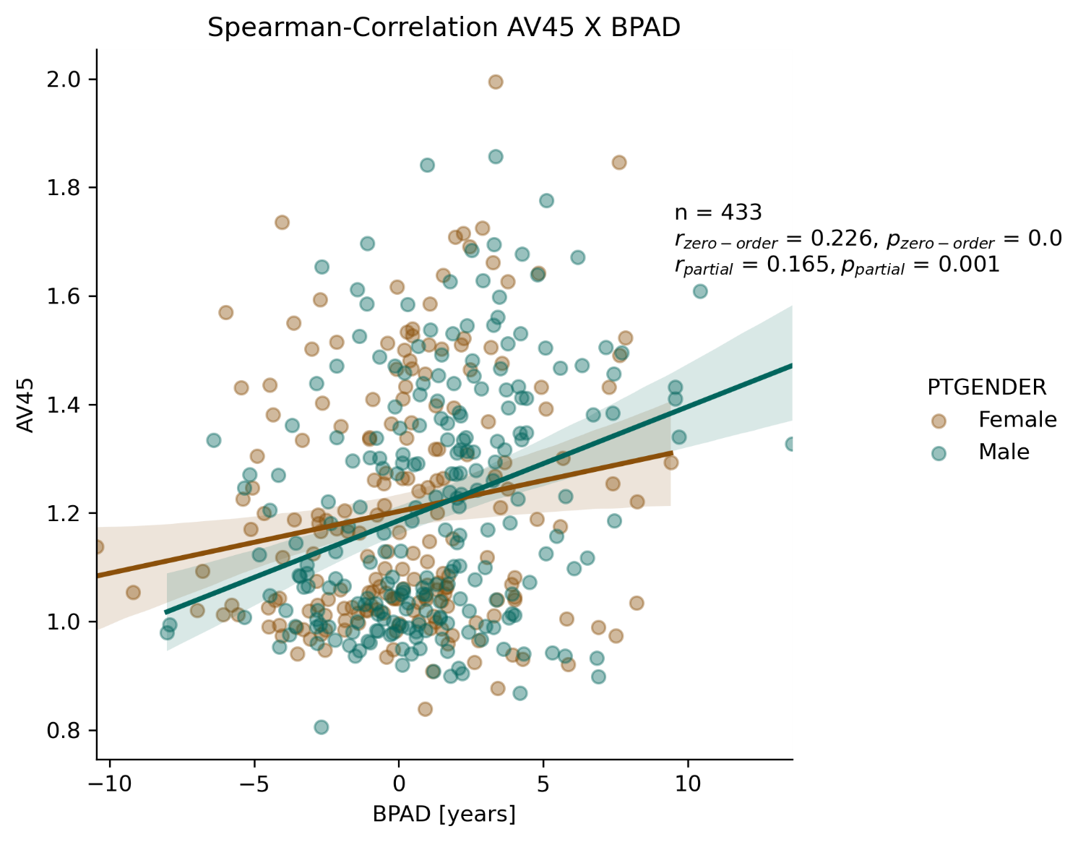
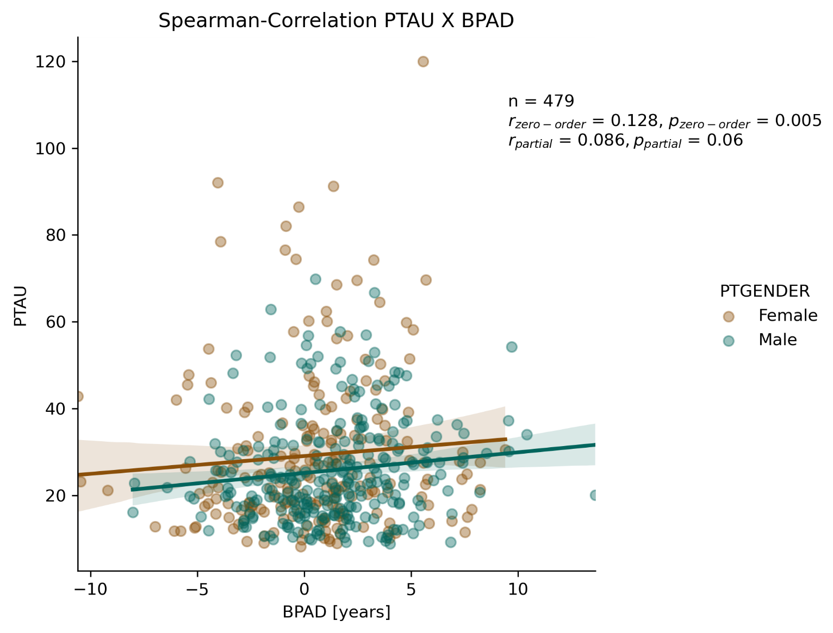
Higher BPAD (both modalities) is associated with more neuropathology
**
**
* Significant at p < 0.05, ** significant after Bonferroni correction
**
**
Stronger associations
Notes:
ADNI-MEM CRANE et al. 2012 XX
Follow-up paper:
YY EDUCATION/SLEEP/BRAIN HEALTH AS MODERATOR YY

Slide 18
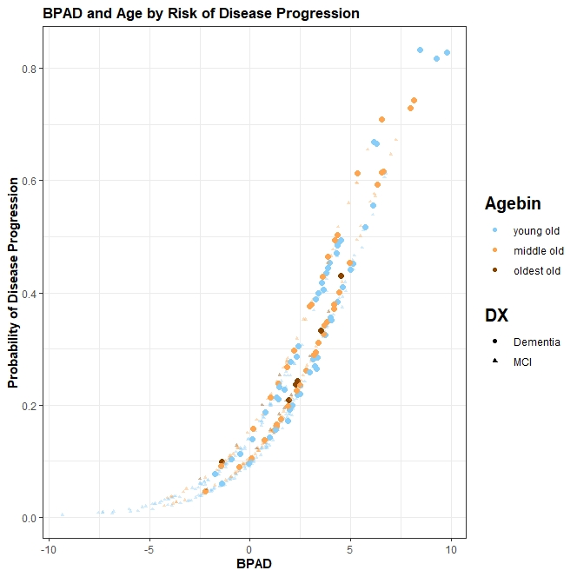
Disease progression can be predicted using MRI-BPAD and Age in MCI
49% increased risk per one year BPAD to progress to AD within two years (95%CI [35%, 66%])*
*age and sex not significant in logistic regression
Disease progression not significantly associated with PET-BPAD in MCI
Logistic Regression
y = -2.35+0.40*BPAD-0.44*(Sex=Male)+0.01*Age
AUC = 0.77
49%

Slide 19
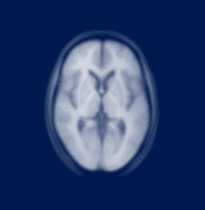
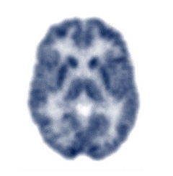
And the winner is…
Precision of brain age
Cognitive Performance
AD Neuropathology
Disease Progression
CN
MCI
Not expected to be precise
FDG-PET-predicted age better captures early disease-related neuropathology and risk.
Onset of tau-related neurodegeneration and of objective cognitive decline is more strongly associated with signals of increasing brain age on MRI.

Slide 20

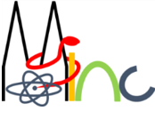














Thank you for your attention!
Dr. Gérard Bischof
(PostDoc)
Dr. Kathrin Giehl
(Study coordinator)
Dr. Merle Hönig
(PostDoc)
MultiModal
Prof. Dr. Thilo van Eimeren
Head of MMNI Group,
Dpt. of Neurology & Nuclear Medicine
Dr. Hendrik Theis
(MD)
NeuroImaging
Elena Doering
(PhD student)
Group.de
Verena Dzialas
(PhD student)
Julia Pfeil
(PhD student)
Prof. Dr. Alexander Drzezga
Head of Dpt. Nuclear Medicine
& INM-II, Research Center Jülich
Magdalena Banwinkler
(PhD student)
Adrian Asendorf
(PhD student)
Notes:
Finally, I would like to thank my team and you for your attention. I am happy to answer any of your questions.

Slide 21
References
Silverman DH. Brain 18F-FDG PET in the diagnosis of neurodegenerative dementias: comparison with perfusion SPECT and with clinical evaluations lacking nuclear imaging. J Nucl Med. 2004 Apr;45(4):594-607. PMID: 15073255.
Farrell, C., Chappell, F., Armitage, P.A. et al. Development and initial testing of normal reference MR images for the brain at ages 65–70 and 75–80 years. Eur Radiol 19, 177–183 (2009). https://doi.org/10.1007/s00330-008-1119-2

Slide 22
Compare precision of brain-predicted age in CN
5-fold cross-validation
Support Vector Regression (SVM)
70 % training data (n = 256)
Relevance Vector Regression (RVM)
- Final model: smallest mean absolute error (MAE) across validation folds
Evaluation on independent test sets
30% testing data (n = 123)
External validation set (n = 59)
Notes:
OUTLIER EXCLUSION? XX

Slide 23
Brain age is almost exclusively predicted with MRI
FDG-PET and MRI are strongly associated with aging
Potential of the two modalities to predict brain age has not been compared
Vast majority of brain age prediction approaches focuses exclusively on MRI

Slide 24

Brain metabolism and volume decline with age
¹⁸F-FDG-PET
^{Structural MRI}
Brain ¹⁸F-FDG-PET is used to visualize metabolic activity in the brain.
Brain MRI provides information on the shape, size and integrity of the brain.
Age: 53
Age: 65-70
Age: 85
Age: 75-80
Dukart et al., 2013
Silverman et al., 2004; Farrel et al, 2009
Notes:
FDG-PET displays greater and more consistent changes as compared to structural MRI at early stages of AD

